Slide 1









CZECH PROPERTY OWNERS ON BOARD!
UIPI RENOVATION TOUR
PRAHA
20. BŘEZNA 2025
Spolufinancováno Evropskou unií. Názory a stanoviska uvedená v tomto dokumentu jsou výhradně názory autora(ů) a nemusí nutně odrážet názory Evropské unie nebo Evropské výkonné agentury pro klima, infrastrukturu a životní prostředí (CINEA). Evropská unie ani poskytovatel grantu za ně nenesou odpovědnost.

Slide 2
UIPI RENOVATION TOUR
CZECH PROPERTY OWNERS ON BOARD!
WORKSHOP 1:
NÁSTROJE NA PODPORU MAJITELŮ

Slide 3

WORKSHOP 1:
NÁSTROJE NA PODPORU MAJITELŮ
Dr. Civ.eng.-arch. Erwin Mlecnik, Assistant Professor, Delft University of Technology (TUDelft), představitel projektu CondoReno

Slide 4
Renovating Condominiums Services and tools supporting homeowner associations
Dr. Civ.eng.-arch. Erwin Mlecnik
Delft University of Technology, The Netherlands
UIPI Renovation Tour
Czech Technical University in Prague, 20 March 2025

Slide 5
CONTENT
01
Energy-saving Renovations
02
Best-practice Examples
03
Renovation Services
04
Tools
05
Conclusion

Slide 6
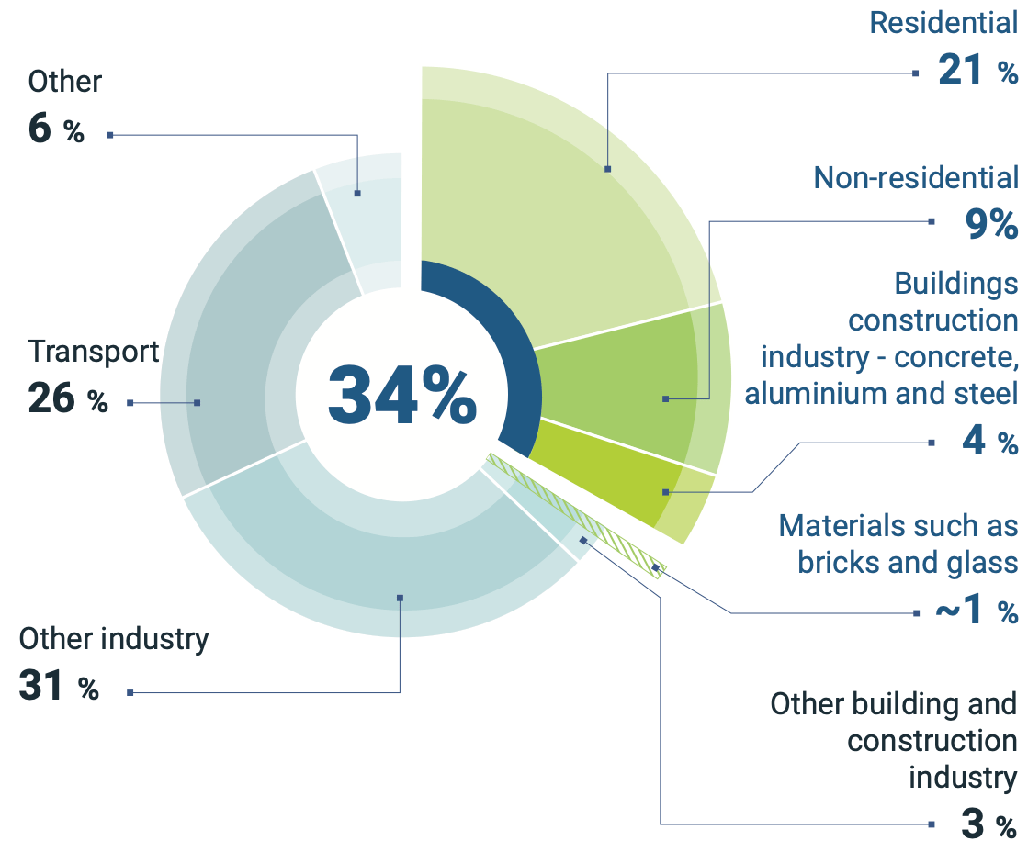
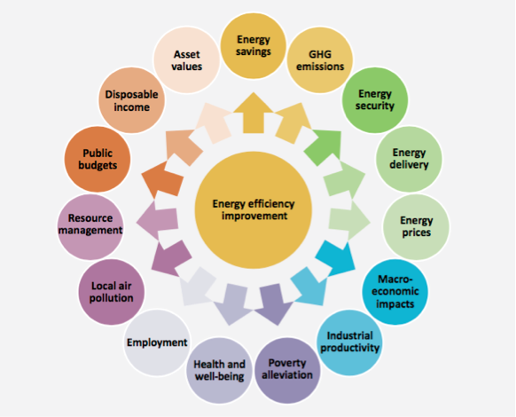
Energy-saving renovations
Sources: Global share of buildings and construction final energy demand, 2021 (UN, 2021) & The multiple benefits of energy efficiency improvements (IEA 2014)
Notes:
Erwin

Slide 7
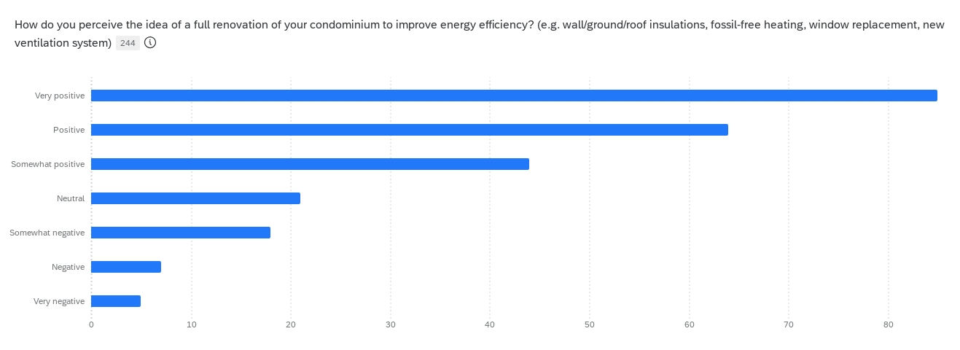
Energy-saving renovations
Source: Ragy Elgendy, questionnaire for homeowner associations, 244 respondents d.d. 3-7-2025, CondoReno-project
Notes:
Erwin

Slide 8
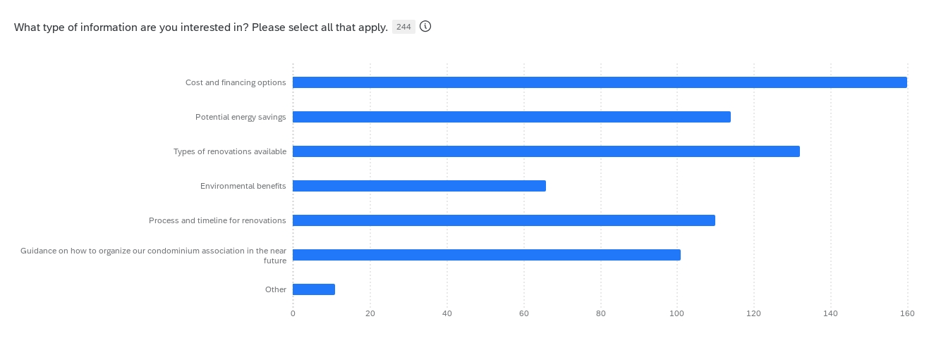
Energy saving renovations
Source: Ragy Elgendy, questionnaire for homeowner associations, 244 respondents d.d. 3-7-2025, CondoReno-project
Notes:
Erwin

Slide 9
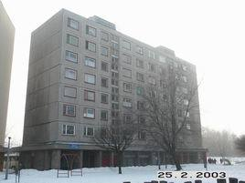
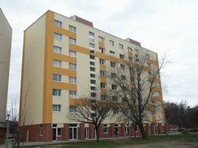
Best-practice examples
7-storey panel building renovation
Dunaújváros, Hungary
SOLANOVA was realized in 2005 as the first "Eco-buildings" project of the European Commission in Eastern Europe dealing with a "major renovation" of a large existing building
The building was transformed into Europe’s first 3-litre-panel-building by consequently applying the passive-house-philosophy
Measured annual space heat consumption 2006/07: 20 kWh/m² - a decrease of more than 90%!
Before renovation After renovation
Pictures © Andreas Hermelink, University of Kassel
Notes:
Erwin

Slide 10
Best-practice examples
Performance guaranteed renovation 2023 Flat Ellen, Assen, The Netherlands
• 90% reduction of energy need for heating (guarantee EnerPHit)
• No major maintenance expected after renovation for about 30 years
• Average savings 1087 EUR/year/household 30 years
Energy performance contract feasible
Before renovation After renovation
Images © Carl-Peter Goossen, Bouwnext
Notes:
Erwin

Slide 11

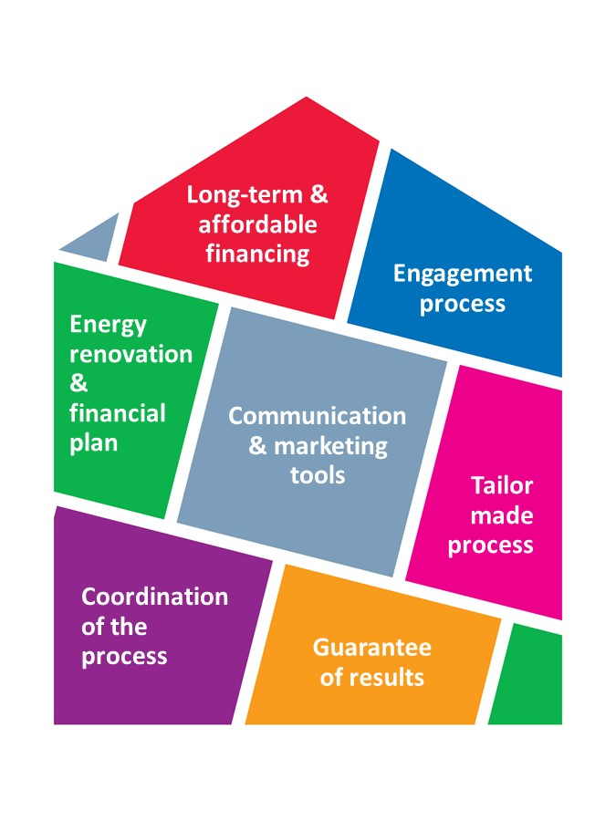
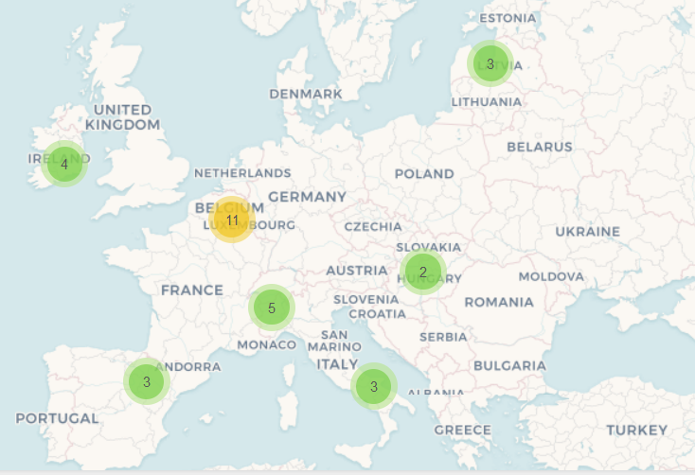
Renovation Services
Local One-Stop Shops provide Integrated Home Renovation Services (IHRS) that make the complex renovation process simple, tailor-made and accessible to all homeowners
>100 One-Stop Shops providing IHRS to homeowners in Europe
Litoměřice
ECÚK

Slide 12
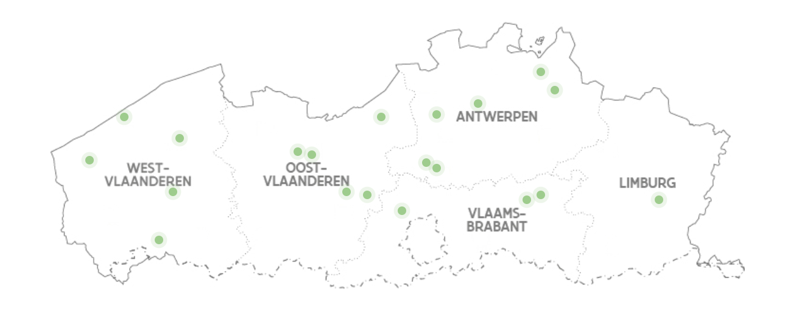
Renovation Services
LIFE-project CondoReno: Development of integrated home renovation services for condominium homeowners in the Netherlands and Flanders
In Flanders 20 “energy houses” provide facilitation of decision-making
An energy house provides advice and financial support towards citizens for energy savings in homes.
CondoReno partner
Mature services for apartments (3/20)
Emerging/start-up services for apartments (3/20)
No developed services for apartments (14/20)
Notes:
Erwin

Slide 13
Renovation Services
LIFE-project CondoReno: Development of integrated home renovation services for condominium homeowners in the Netherlands and Flanders
In the Netherlands WNR provides an exemplary market-based model
Organisation: Service bureau & building team, tested renovation concepts
Financing: Long-term financing calculated in service costs,
loan based on government fund
Guarantee: WNR licences, building performance guarantee, quality assurance, guarantee on engineering costs
Process: Feasibility research, design, engineering,
realisation, maintenance, monitoring, replacement
CondoReno partner
Notes:
Erwin

Slide 14
Tools
LIFE-project CondoReno: Development of integrated home renovation services for condominium homeowners in the Netherlands and Flanders
CondoReno already developed multiple support for IHRS
Research: Barriers/opportunities analysis, Stakeholder analysis,
EU IHRS business models overview
Process: Roadmap, training overview, learning network,
digital resource centre
Policy: Fund development, best-practice policy instruments
See: https://condoreno.org
Notes:
Erwin

Slide 15
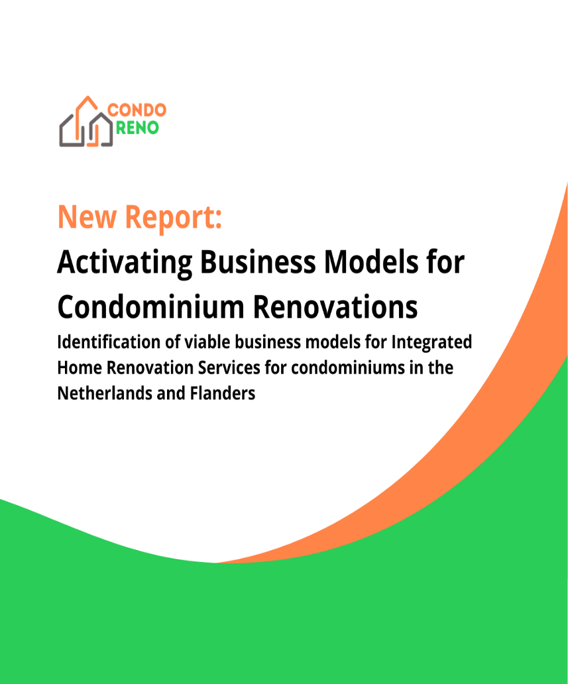




Tools: research
Possible models to create Integrated Home Renovation Services
Public model
For example, Municipal services of “energy houses” in Antwerp, Mechelen and Ostend in Belgium
Private model
For example, Living-cost neutral renovation services of non-profit organization WNR in the Netherlands
Agency model
For example, CoachCoPro services Agence Parisienne du Climat in Paris

Slide 16
integrated home renovation service providers
Tools: process
Decision to apply for a feasibility study
Decision to invest in renovation
Decision to start the renovation
Communication strategy
Gaining trust
Appointing a manager
Propositions and scenarios
Providing financial insight
Leading the process
Matchmaking supply and demand
Legal development
Performance agreements
private condominium homeowners
Notes:
Erwin

Slide 17
Tools: policy
SVVE (NL): national subsidy for homeowner associations carrying out energy saving measures,sustainable heat options and a Highly Energy-efficient Package. Extra subsidy for additional measures and renovation guidance.
SPOR (NL): national subsidy for min. 30 owners for hiring a process guide.
National Heat Fund (NL): low-interest loan without transaction costs for homeowner associations for carrying out energy saving measures. Max. €35.000 per apartment right. Some municipalities offer extra interest rate reduction.
SvN (NL): loan for homeowner associations dealing with a back log in maintenance of apartment buildings, offered by participating municipalities and provinces
District-related subsidies (NL): e.g. Amsterdam SouthEast: 70% subsidy under conditions: no backlog in maintenance, min 3 energy label steps improvement
SAH (NL): subsidy for connecting to a heat grid for mixed homeowner associations and housing associations
“Emergency buyer” fund (BE): for vulnerable households to improve living conditions and energy saving (interest-free loan that is only being paid back after 20 years)
Notes:
Walter

Slide 18
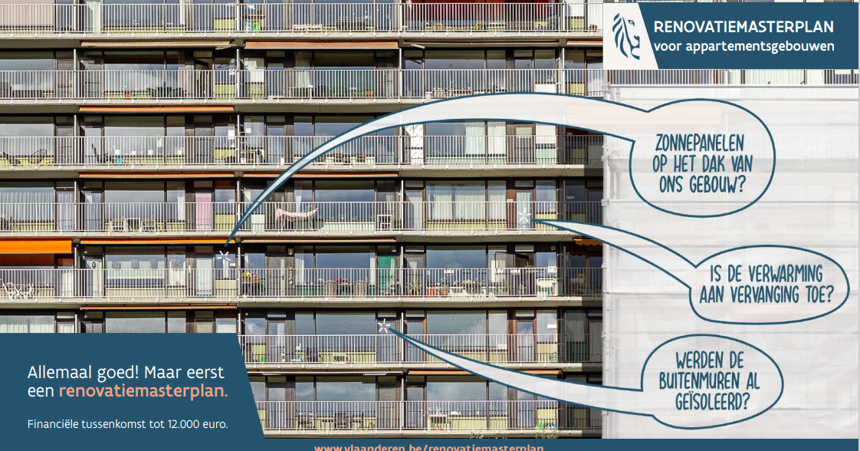
Tools: policy
Flanders, Belgium:
Mandatory Energy Performance Certificate for common building parts
Local: no rent of roof apartments when roof insulation is lacking
Pool of renovation master planners
The Netherlands:
Mandatory minimum deposit of homeowners for the reserve fund for homeowner associations
Collective development demand-offer to go to gas-free districts
Notes:
Walter

Slide 19
Conclusion
Integrated home renovation services are needed and can be succesfully developed for homeowner associations targeting deep renovation of condominiums
Attention!
Compared to individual homeowners, homeowner associations need adapted guidance
Various business models are possible
Integrated services preferably engage in the whole process
Monthly financial and energy-saving should be provided
Policy is rapidly changing
Notes:
Walter

Slide 20




How to find us
THANK
YOU
CondorenoLife
Life_CondoReno
condoreno.org
LIFE21-CET-HOMERENO-CondoReno
This project has received funding from the European Union’s Programme for Environment and Climate Action (LIFE) MGA — Multi & Mono, under grant agreement No. 101076316. Views and opinions expressed are however those of the author(s) only and do not necessarily reflect those of the European Union or CINEA. Neither the European Union nor the granting authority can be held responsible for them.

