Slide 1


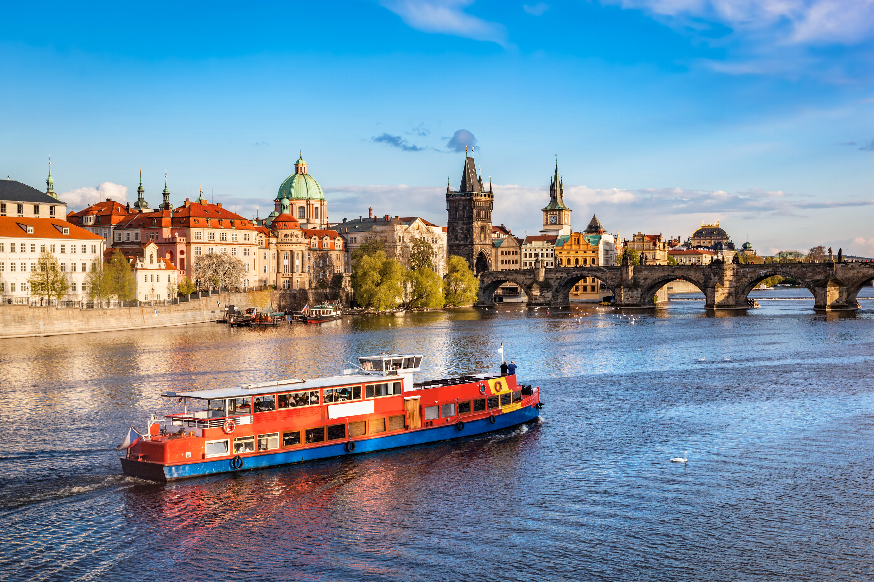




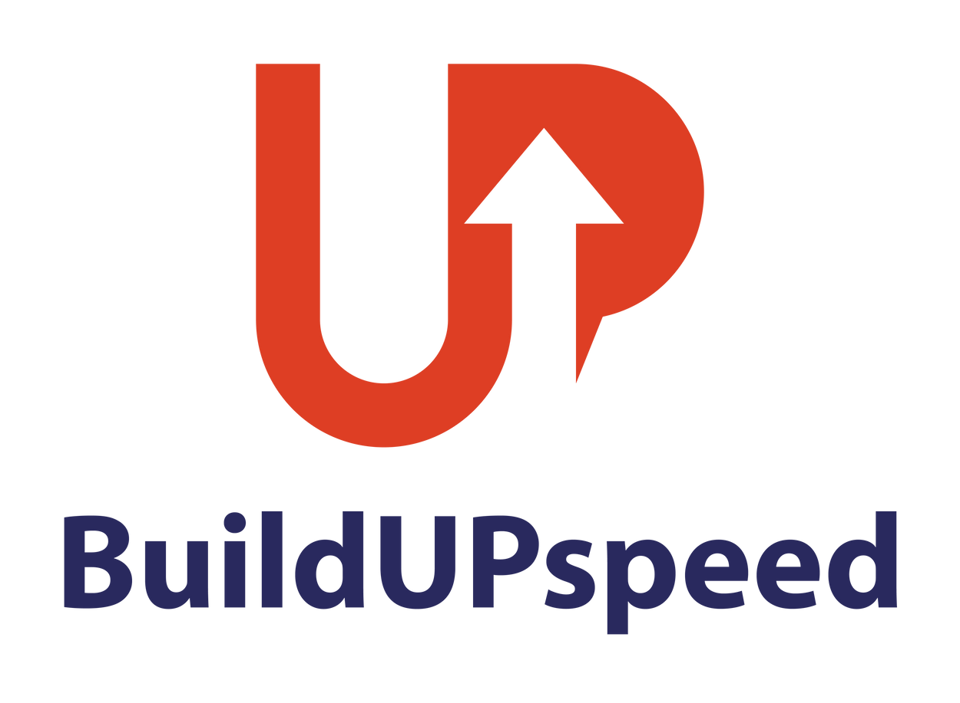

CZECH PROPERTY OWNERS ON BOARD!
UIPI RENOVATION TOUR
PRAHA
20. BŘEZNA 2025
Spolufinancováno Evropskou unií. Názory a stanoviska uvedená v tomto dokumentu jsou výhradně názory autora(ů) a nemusí nutně odrážet názory Evropské unie nebo Evropské výkonné agentury pro klima, infrastrukturu a životní prostředí (CINEA). Evropská unie ani poskytovatel grantu za ně nenesou odpovědnost.

Slide 2
UIPI RENOVATION TOUR
CZECH PROPERTY OWNERS ON BOARD!
WORKSHOP 2: EFEKTIVNÍ A CENOVĚ DOSTUPNÁ OBNOVA BUDOV Z 50. A 60. LET

Slide 3

WORKSHOP 2: EFEKTIVNÍ A CENOVĚ DOSTUPNÁ OBNOVA BUDOV Z 50. A 60. LET
Ana Verónica Martínez, MSc., technický a projektový referent, UIPI, představí projekt BuildUpSpeed

Slide 4


Bridging the Gap: Connecting the Market, Innovative Solutions, and Professionals
Ana Veronica Martinez - UIPI
Notes:
Welcome words
Present my self and the team
The overall aim of BuildUpSpeed is to accelerate the volume and depth of deep renovation of the EU building stock, supporting the EU renovation wave.
This will be done by the introduction and implementation of a Market Activation Platform, an online open source, specifically for the promotion and implementation of industrialized renovation solutions.

Slide 5

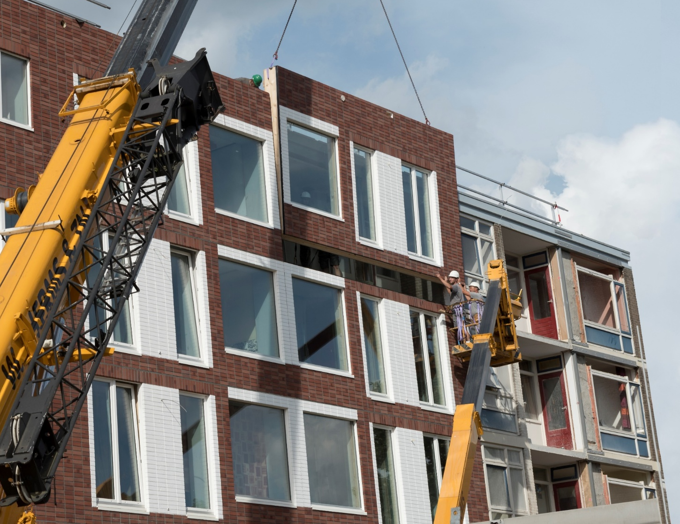
Why BuildUPspeed?
Need to SPEED UP AND MASSIFY the renovation of our building stock!
We need to find a SUSTAINABLE AND SCALABLE WAY to accelerate this process: INDUSTRILISE?
Knowledge and solutions already exists on industrialised, plug and play solutions (notably from research from EU projects)
But construction professionals, potential investors, project managers and market actors are not aware of them
We need to make sure that we CENTRALISE this information, solutions and accompany the uptake: PLATFORM where various actors can go and pick and choose
EU project More Connect project demo
Notes:
BuildUPspeed represents a spin-off from these cluster activities:
Strategic collaborative objective of capitalizing lessons learned and key exploitable results
To make the step from exploitation to a real market uptake of innovative renovation practices in Europe
Focusing on the market uptake of industrialized solutions, both on product and on process, including technical and economic performance in the life cycle, investment risks analysis, innovative crowd-based mechanisms, and the evaluation of the effect on the global environment.
In BuildUPspeed we want to capitalize all the results and outcomes from relevant and related (H2020) projects on deep renovation, specifically projects and actions on prefabrication, modularity, circularity, BIM adaptation for renovation and industry 4.0.
BuildUPspeed will also use the approach and utilize networks of several chapters of the ‘Energiesprong’ and ‘Stroomversnelling’

Slide 6

The BuildUPspeed Objectives
Demand
Supply
Bring the demand side and supply side in the retrofitting market together by scaling up Renovation
Notes:
Why: BuildUPspeed aims to contribute to the decarbonization of the EU building stock and to accelerate deep renovation processes by fostering a market uptake of valuable key results of EU projects and available technologies
BuildUPspeed will develop and implement digital and physical Retrofitting Market Activation Platforms, and will validate them on a national MS level in five Pilot Markets and pop-up Factories, representative of singular social-geographical-economical-policy ecosystems in Europe with the objective for a further roll out in other MS’s and at the European level

Slide 7
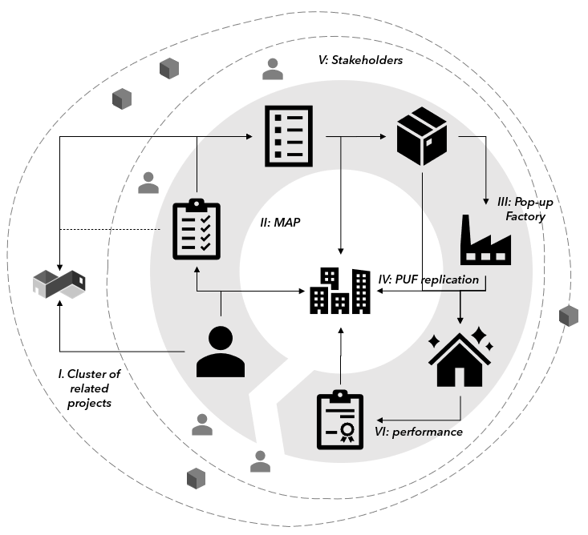
The BuildUPspeed key pillars:
2.
Inventory of needs, actors and capacities, flows within local context.
3.
Market Activation Platform: an online open-source platform
4.
“Local” or “Pop-up” factory concept introduction
1.
5.
BIM modelling, industrialised solutions, networks
Guaranteed performance products
Notes:
Clustering of efforts and evidence capitalizing key outputs on modular and industrialized deep renovation solutions, BIM adaptation, successful networks, etc.
Inventory of (end-user) needs, actors & capacities, (material and energy) flows and buildings & spaces within a local context (i.e., on neighbourhood/eco-system level). This is an important intermediate step before developing a market activation hub
Digitalizing these key outputs to make them attractive to end-users and easily accessible in virtual Market Activation Hub, in an on-line open-source platform. The Hub brings together supply and demand and defines the market for modular deep-renovation products and concepts
Introducing the concept of fully automated ‘Local’ or ‘Pop-up’ factories and implement this as pilots in a five locations in the countries, involved in BuildUPspeed and three additional locations.
Offering attractive and understandable information on evidence-based performances of renovated buildings to user/owners in order to show the potential of industrialized solutions to reduce the performance gap (both on energy and IEQ).
European Bauhaus aims to be a creative and interdisciplinary movement, to develop a meeting space where sustainable practices are recovered, the most visionary current practices are valued and future ways of living are designed, at the crossroads of art, culture and science

Slide 8
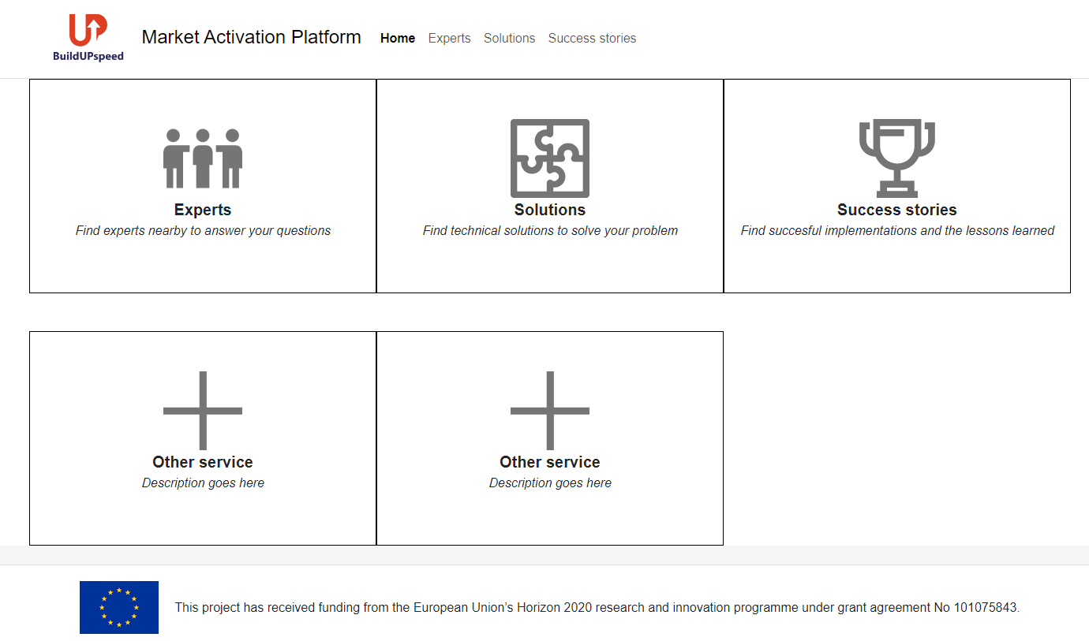
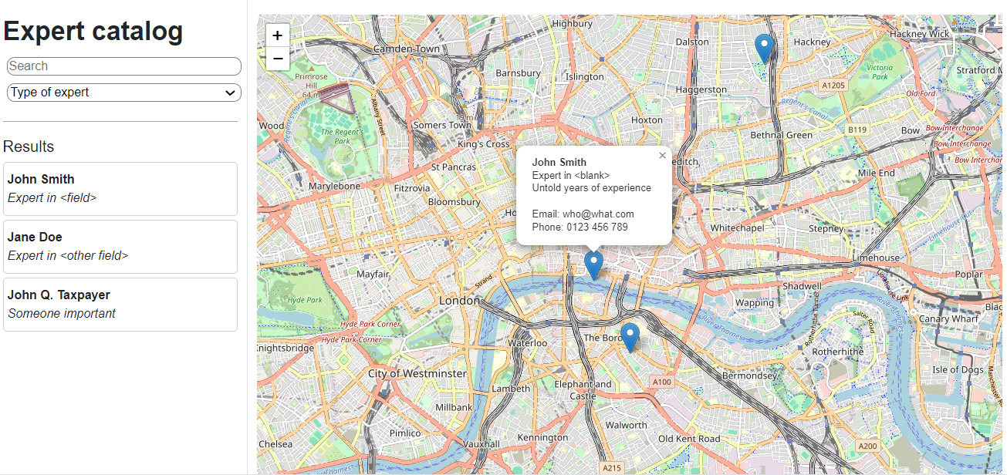
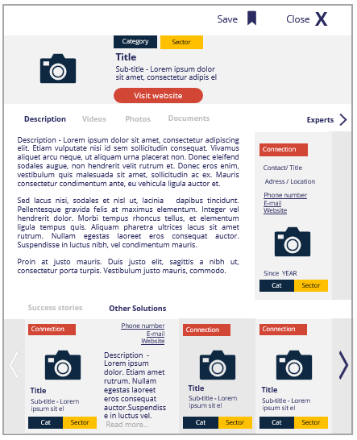
Market Activation Platform
FUNCTIONALITIES
1. Exploration:
What is available for me?
3. Realization:
from IT to real
2. Calculation:
How it fits in my building/plans?
4. Exhibition:
examples of successful cases.
A landing page drives the user to different options
The CATALOGUE screens have a map and a panel
Click on CARDS give more information

Slide 9
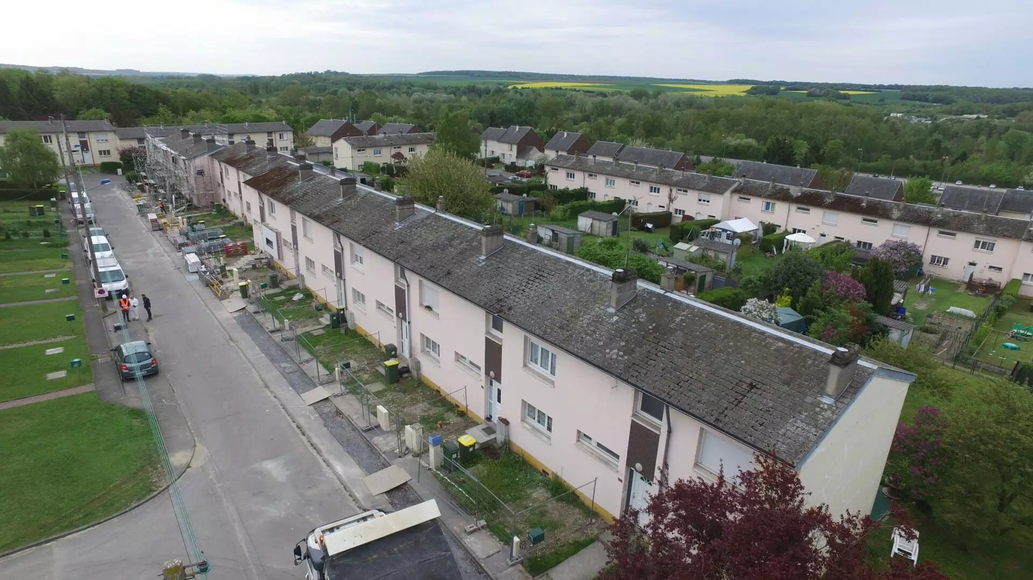
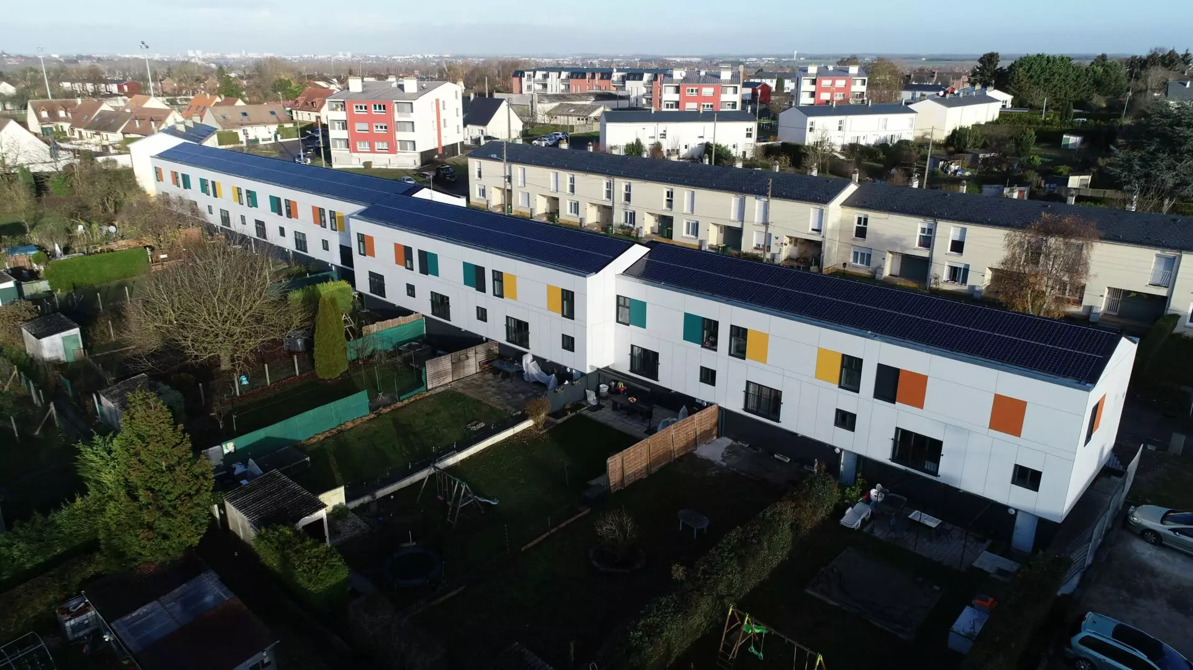
Energiesprong
- Pre-fabricated components
- Sustainable energy systems installation
- No disturbance, rapid implementation
- Cost reduction and comfort increased
- Easy for replicability
Before renovation works:
- DPE: F
- Energy consumption: 19.6 MWh ef/log
- Heating and DHW by gas boiler, single flow CMV and low insulation
After renovation works:
-DPE: A -62 kWhep/m².year
- Energy consumption: 4.9 MWh ef/log
- Heating and DHW by heat pump boiler, double flow CMV and high-performance insulation

