Slide 1


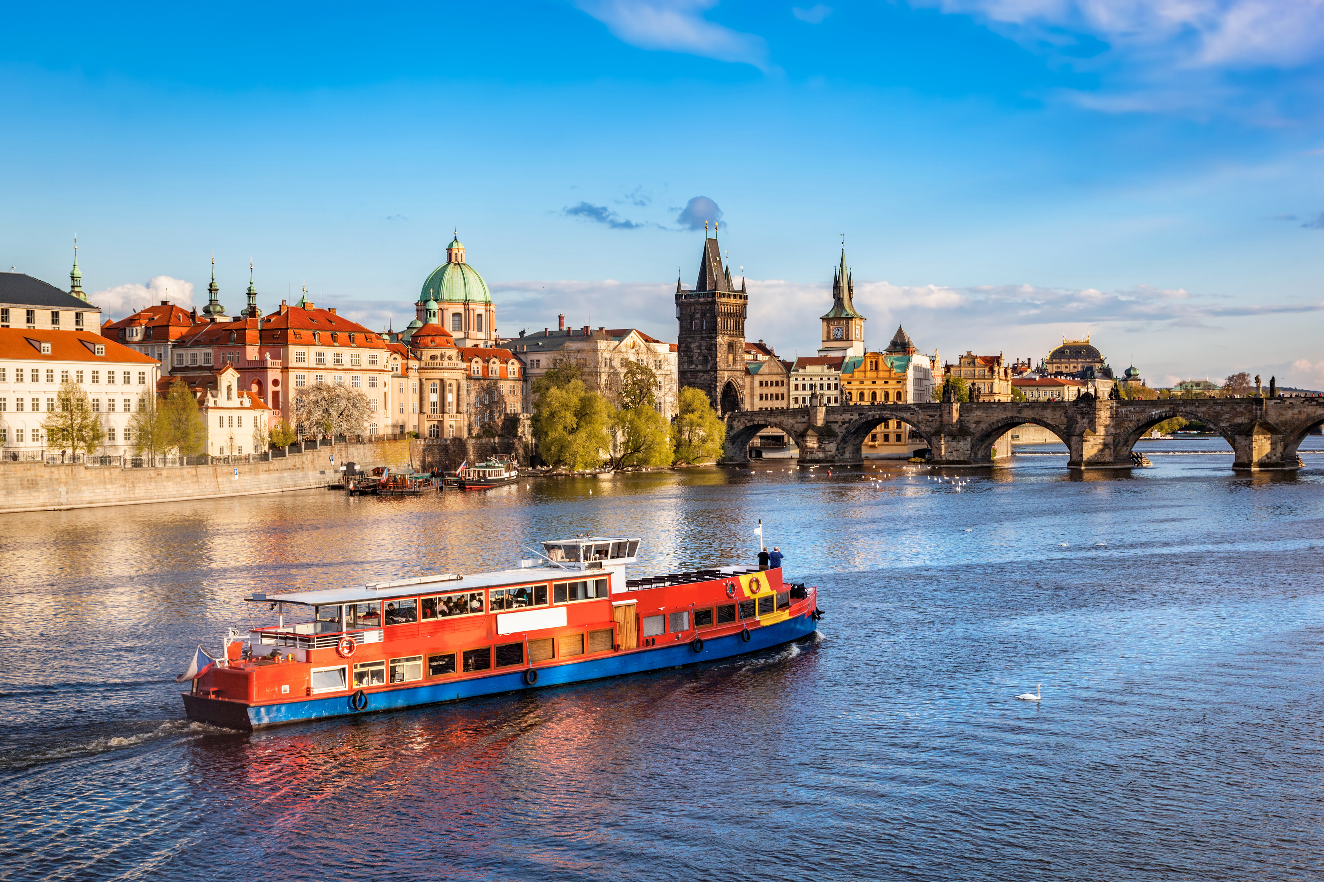






CZECH PROPERTY OWNERS ON BOARD!
UIPI RENOVATION TOUR
PRAHA
20. BŘEZNA 2025
Spolufinancováno Evropskou unií. Názory a stanoviska uvedená v tomto dokumentu jsou výhradně názory autora(ů) a nemusí nutně odrážet názory Evropské unie nebo Evropské výkonné agentury pro klima, infrastrukturu a životní prostředí (CINEA). Evropská unie ani poskytovatel grantu za ně nenesou odpovědnost.

Slide 2
UIPI RENOVATION TOUR
CZECH PROPERTY OWNERS ON BOARD!
WORKSHOP 3: VYTVÁŘENÍ BUDOUCÍCH MĚST A
ZACHOVÁNÍ NAŠEHO DĚDICTVÍ

Slide 3
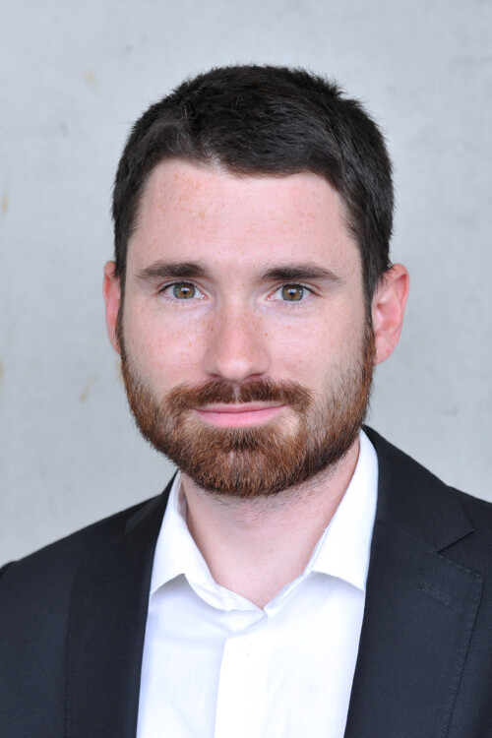
WORKSHOP 3: VYTVÁŘENÍ BUDOUCÍCH MĚST AZACHOVÁNÍ NAŠEHO DĚDICTVÍ
Ing. Mgr. Michal Kuzmič, Vedoucí obchodu a mezioborové spolupráce, Univerzitní centrum energeticky efektivních budov (ČVUT), reprezentant projektu CrAFt

Slide 4
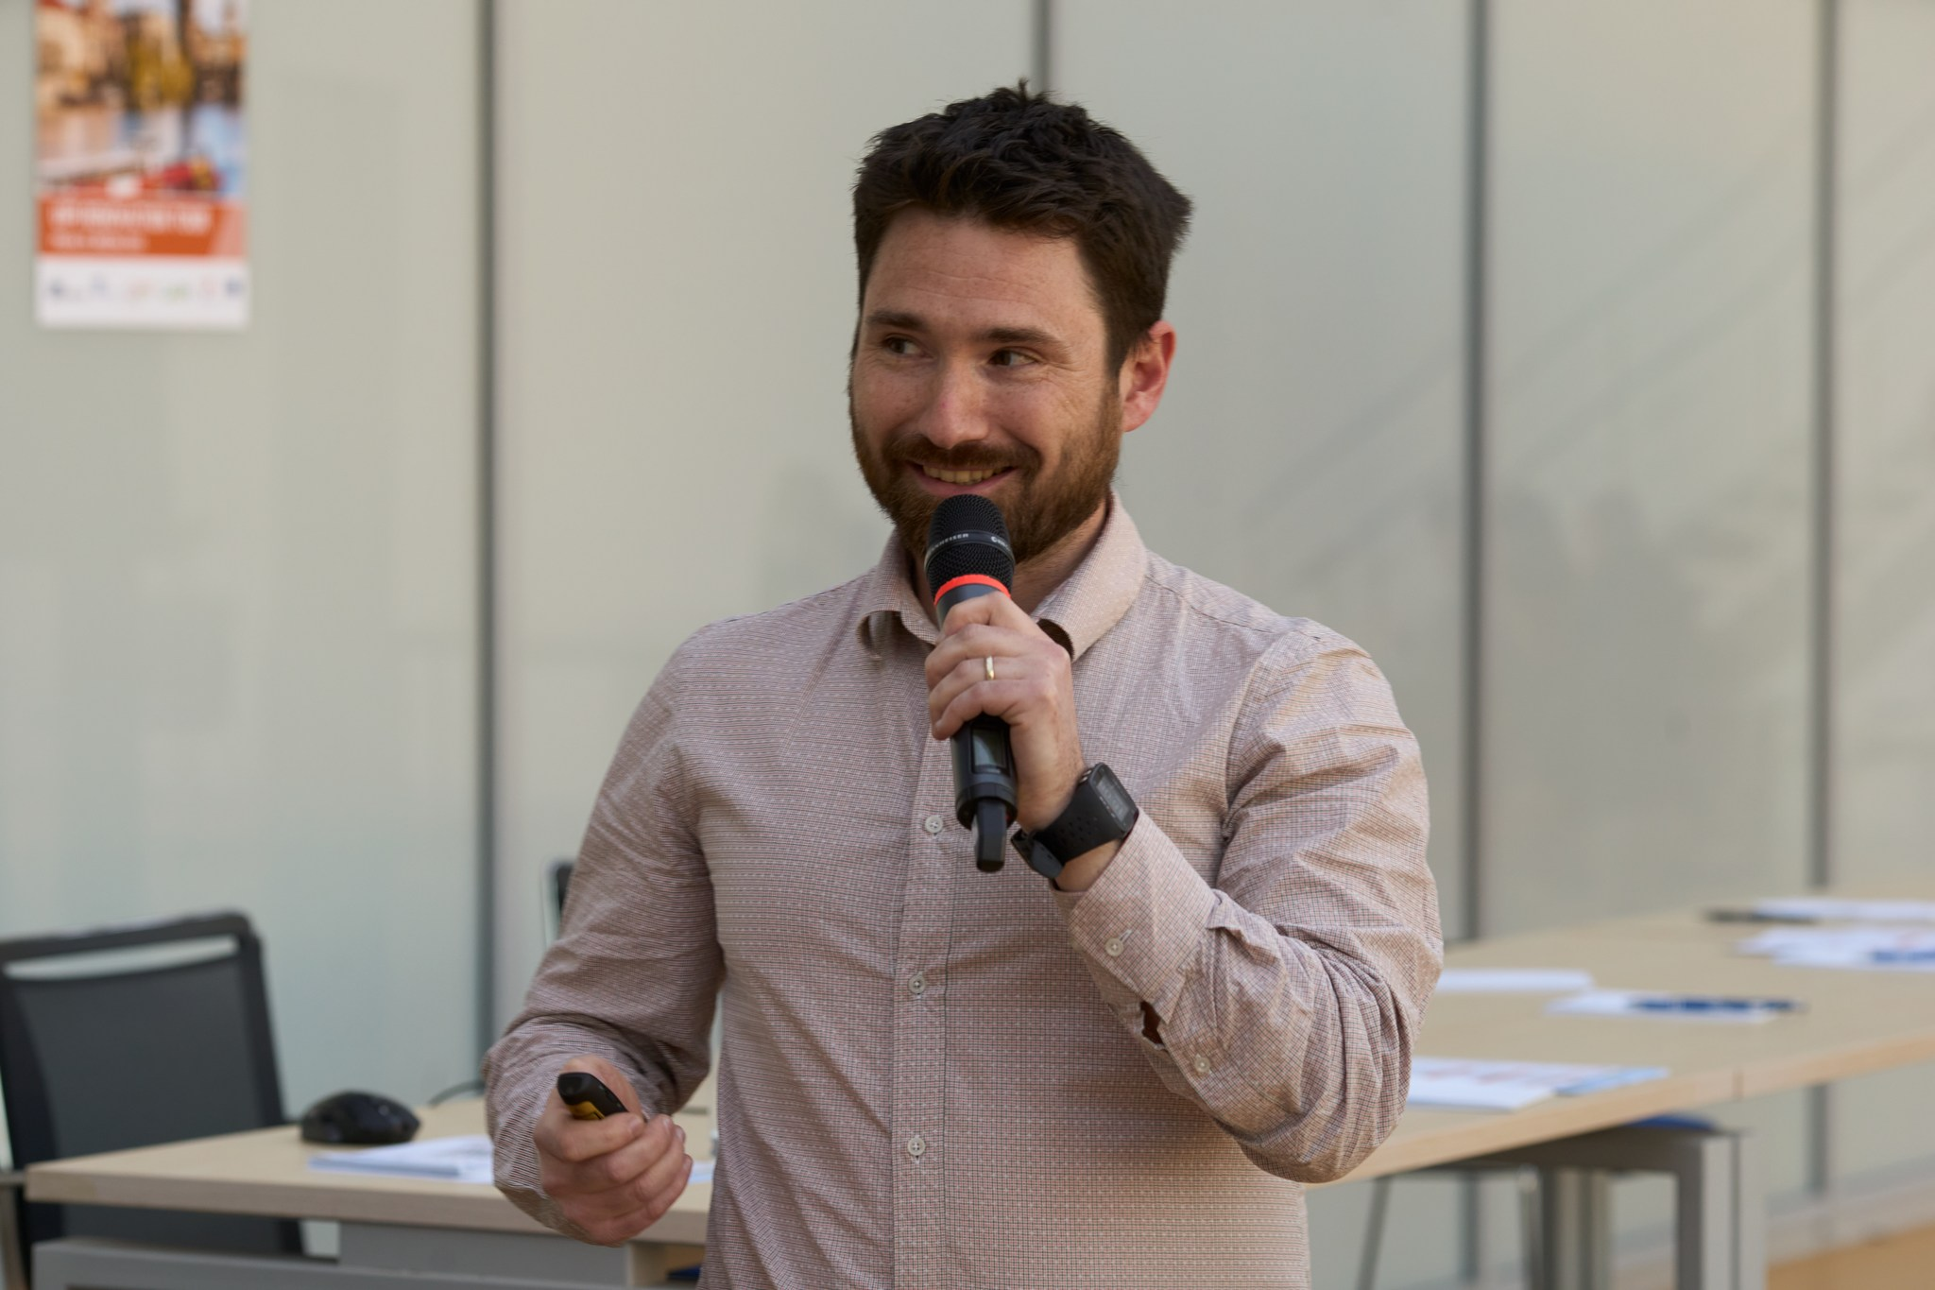
WORKSHOP 3: VYTVÁŘENÍ BUDOUCÍCH MĚST AZACHOVÁNÍ NAŠEHO DĚDICTVÍ

Slide 5
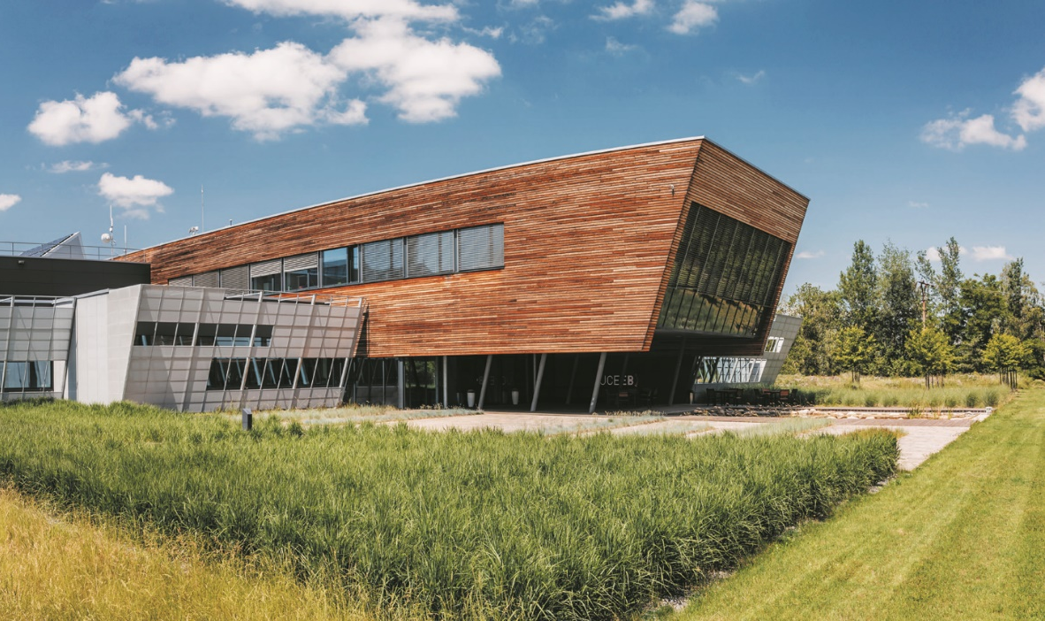
THE BENEFITS OF SHARING
LIVING THE ENERGY TRANSITION IN RESIDENTIAL SECTOR
Michal Kuzmič head of business and interdisciplinary collaboration
20. 03. 2025 uiPI RENOVATION TOUR, PRAGUE

Slide 6
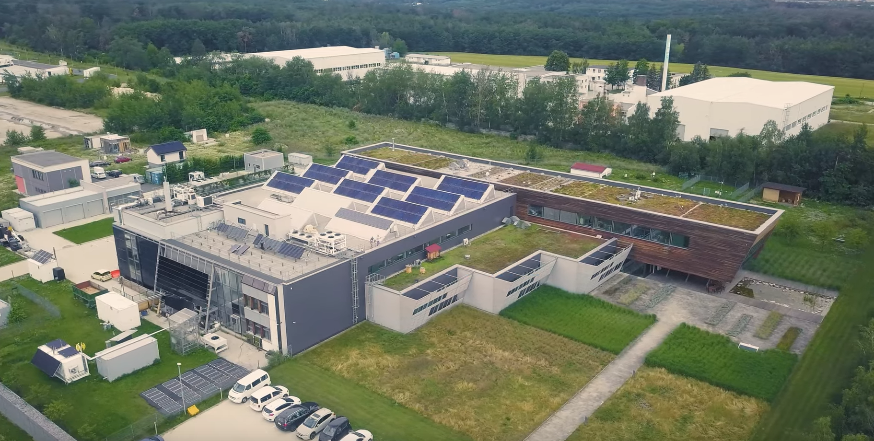
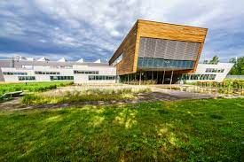
ČVUT UCEEB (TŘINECKÁ 1024 BUSHRAD)
UCEEB
FSv
FS
FBMI
FEL
UCEEB was created thanks to the cooperation of the Faculty of Civil, Mechanical, Electrical and Biomedical Engineering
Building open since 2014
We are a bridge between industry and the university
We focus on buildings and their new technologies
www.uceeb.cz
VIDEO: https://www.youtube.com/watch?v=fnhU0K4HYOo&t=118s
OUR GOALS
Bringing innovation from research to practice
We are consciously playing our part in shaping the future of construction
Our focus are buildings, neighbourhoods and cities
  environmentally friendly
  support the sustainable development of society
  provide their users with a healthy and comfortable indoor environment

Slide 7


























ENERGY INTEGRATION OF BUILDING CLUSTERS
Carbon-neutral and positive energy districts
Resource design for existing and new building sets
De-carbonisation of heat supply systems
Energy sharing groups, energy communities
Energy flexibility management
Listed buildings
NCK CAMEB
OPTICOMM
PARTYSOFT
POWER2HEAT4CITIES
RESPED

Slide 8
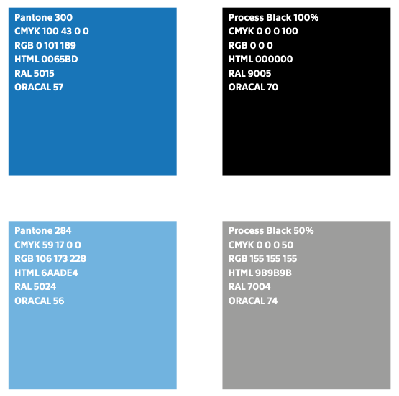
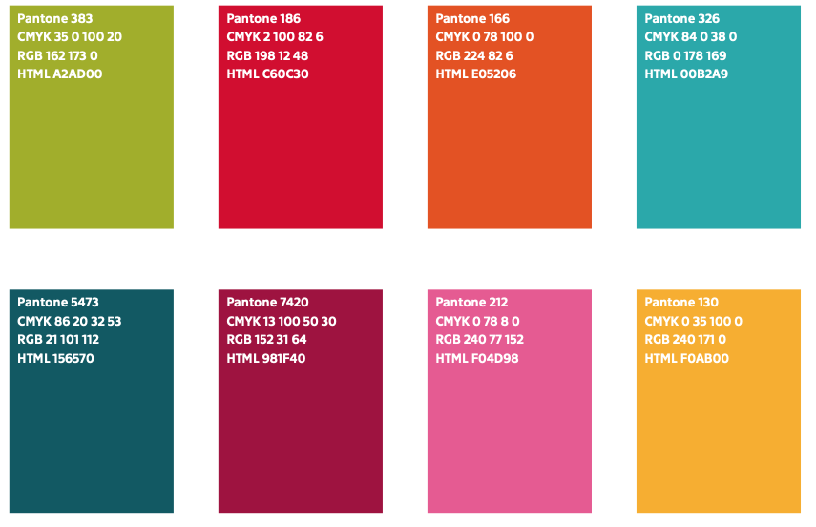
ENERGY COMMUNITY LEVELS
SOCIAL
EC SECURITY
ECONOMIC
TECHNICAL REDISTRIBUTION
LOCAL AGGREGATOR
DAY-AHEAD
TECHNICAL
EC'S RESPONSIBILITY TO THE NETWORK
CYBERSECURITY
COMMUNITY
RESILIENCE
MANAGEMENT
ECOLOGICAL OPTIMIZATION
SMART MANAGEMENT
STABILISATION OF THE TRADER
DIMENSIONS OF ASSETS
LDS
FINANCIAL REDISTRIBUTION
POWER BALANCE SERVICES
SOCIAL RESPONSIBILITY
FAIR REDISTRIBUTION
Source: Josef Haber, CTU UCEEB

Slide 9
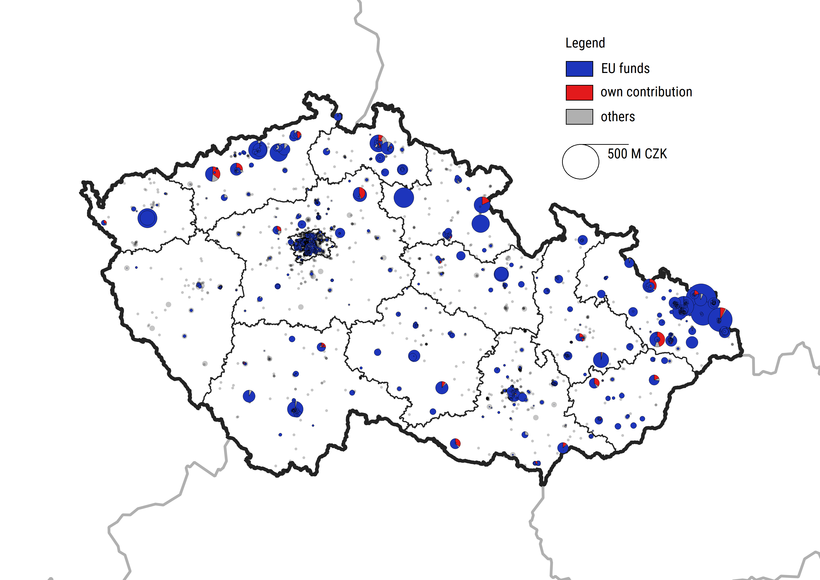
In Czechia, state-led policy matters: channelled to post-industrial Northern areas
Financial support for housing cooperatives in Czechia concentrates
in two subregions.
These are subregions historically dependent on coal mining - lignite mines in Most Basin (North Bohemia) and black coal in Ostrava-Karvina Basin (North Moravia-Silesia).
Instruments such as Green Savings, Panel+.
Source: Jan Frankowski, Tomasz Świetlik, Aleksandra Prusak, Joanna Mazurkiewicz, Jakub Sokołowski, Wojciech Bełch, Nicol Staňková. Housing cooperatives facing the energy transition. Insights from Poland and Czechia, OPUS call in the Weave programme (2021/43/I/HS4/03185).

Slide 10
Energy renovation investments reduce emissions and generate savings, but to a limited extent
Average value of primary energy consumption
before and after energy renovations
Average annual value of central heating consumption
before and after energy renovations
Source: own elaboration based on Statistics Poland: Development of methodology and realisation of a survey of a thermo-modernization activity scale in multi-dwelling residential buildings. In the report, data were collected for the period 2010-2016.

Slide 11
Differentiated impacts of energy crisis
Case Česká Lípa (OSBD)
More aCentral Co-op OSBD Česká Lípa was continuously dissatisfied with policy of the foreign district heating system operator.
nd more buildings cut off the system and left the OSBD.
The heating system was endangered by economic and technical collapse
OSBD fixed costs per housing unit rose.
SOLUTION: OSBD stepped into the district heating operator by buying 20% shares
The crisis affected mostly buildings individually heated by natural gas.
The government introduced a flat subsidy for electricity, natural gas and heating for each household in Czechia.
The trend of cutting off from the district heating grids was reversed -
now raising interest in being connected (e.g. Kutná Hora).
Rising interest in renewable independent energy sources.

Slide 12
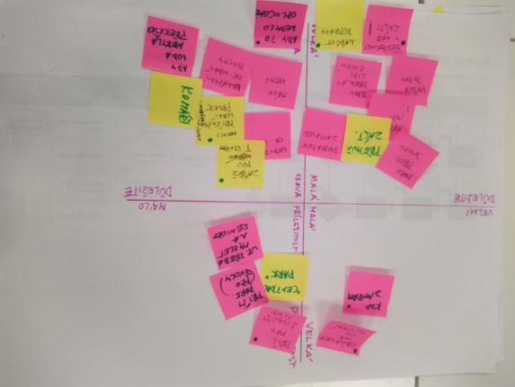
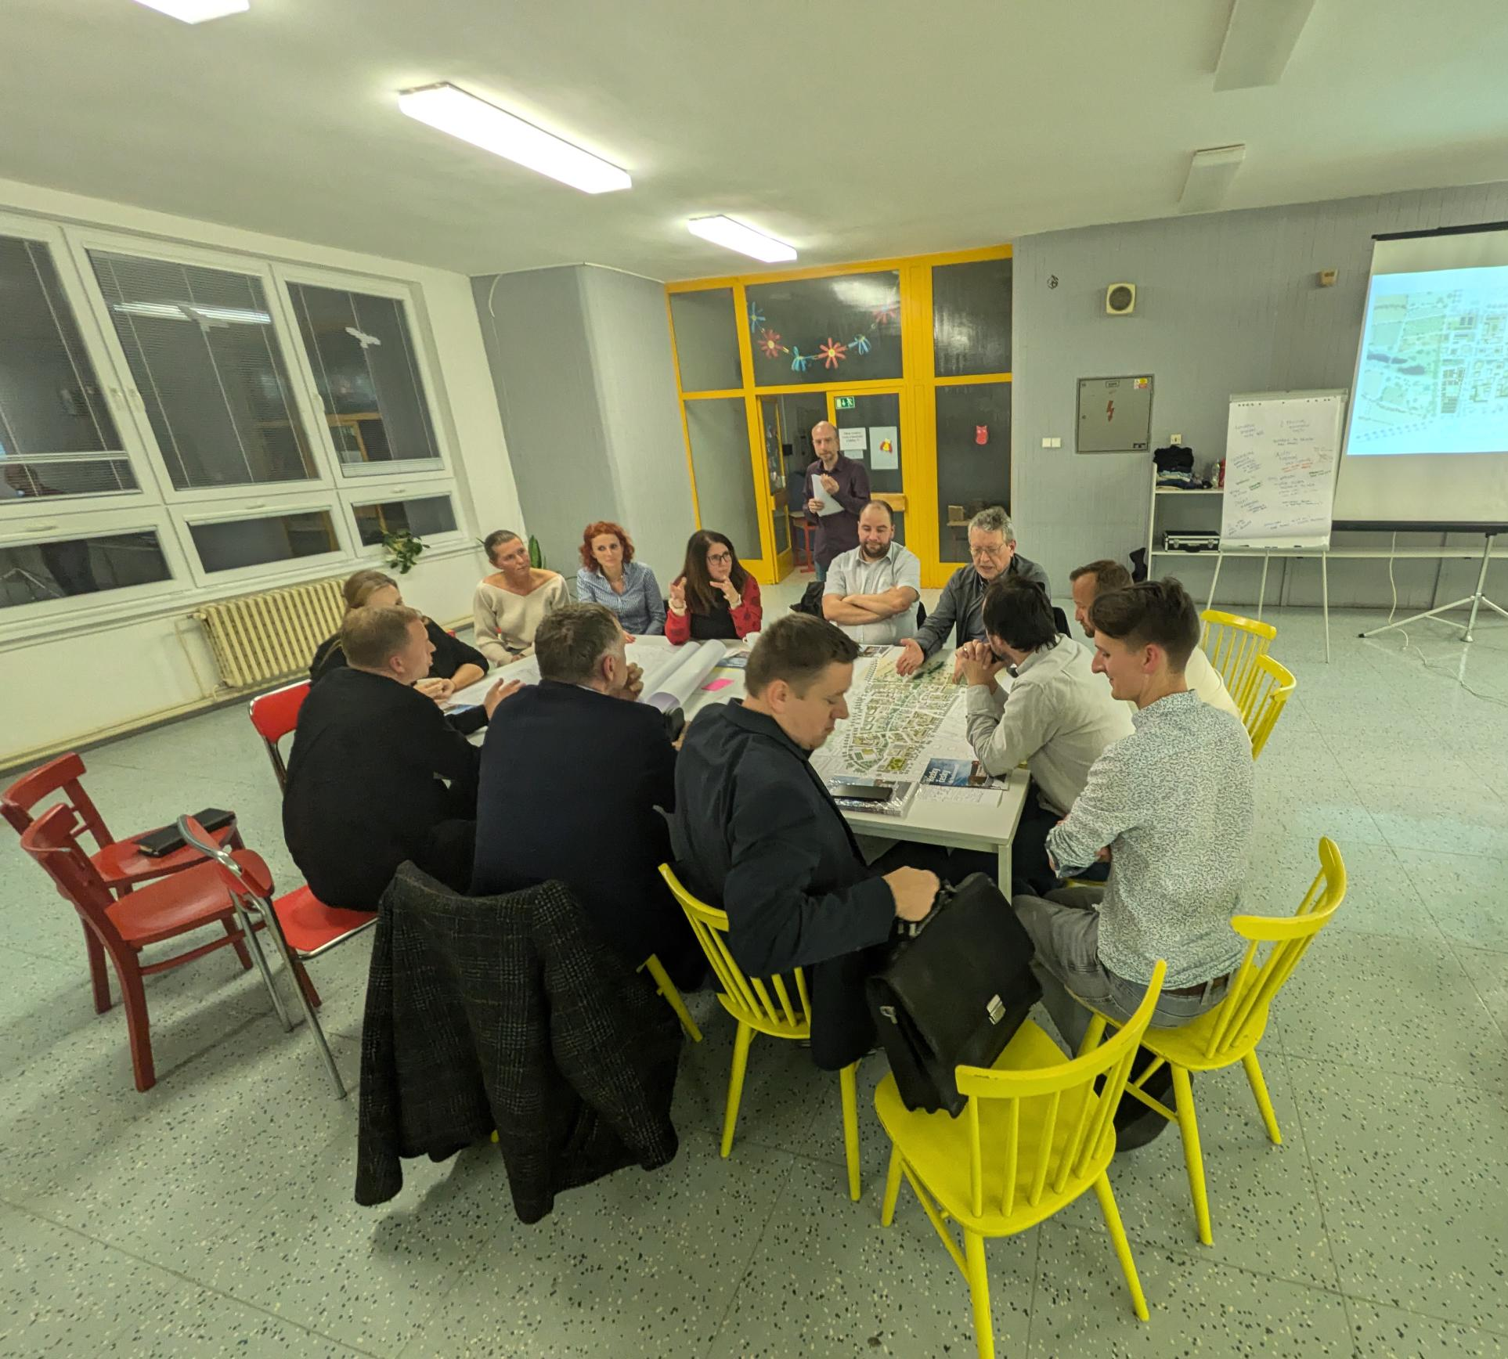
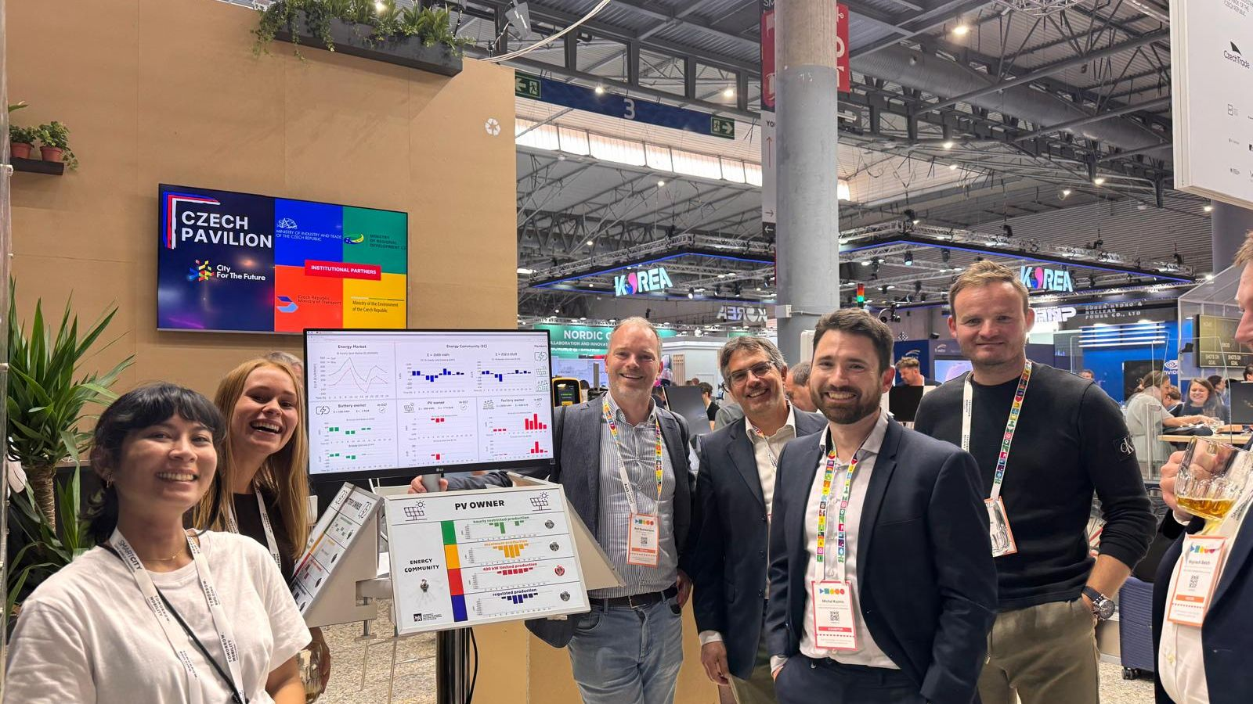
ENERGY COMMUNITIES
Residential sector mobilisation
Mobilization
Redistribution
Gamification

Slide 13
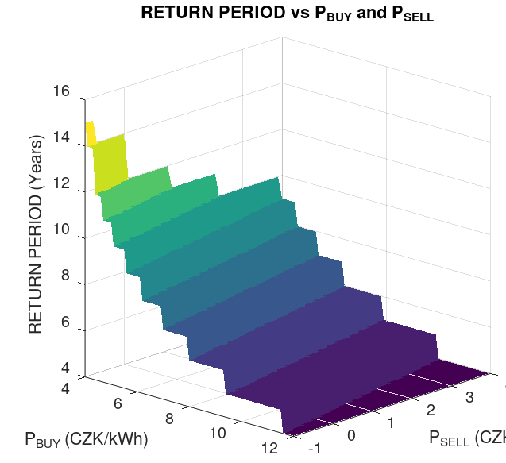
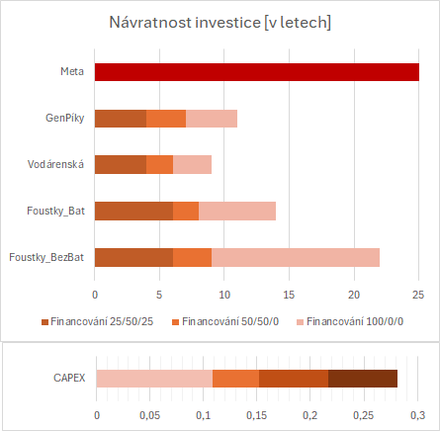
ENERGY COMMUNITY CONCEPT
Economy at individual block of flats level
Return period, based on financing modality
Source: Wojciech Belch, CTU UCEEB

Slide 14
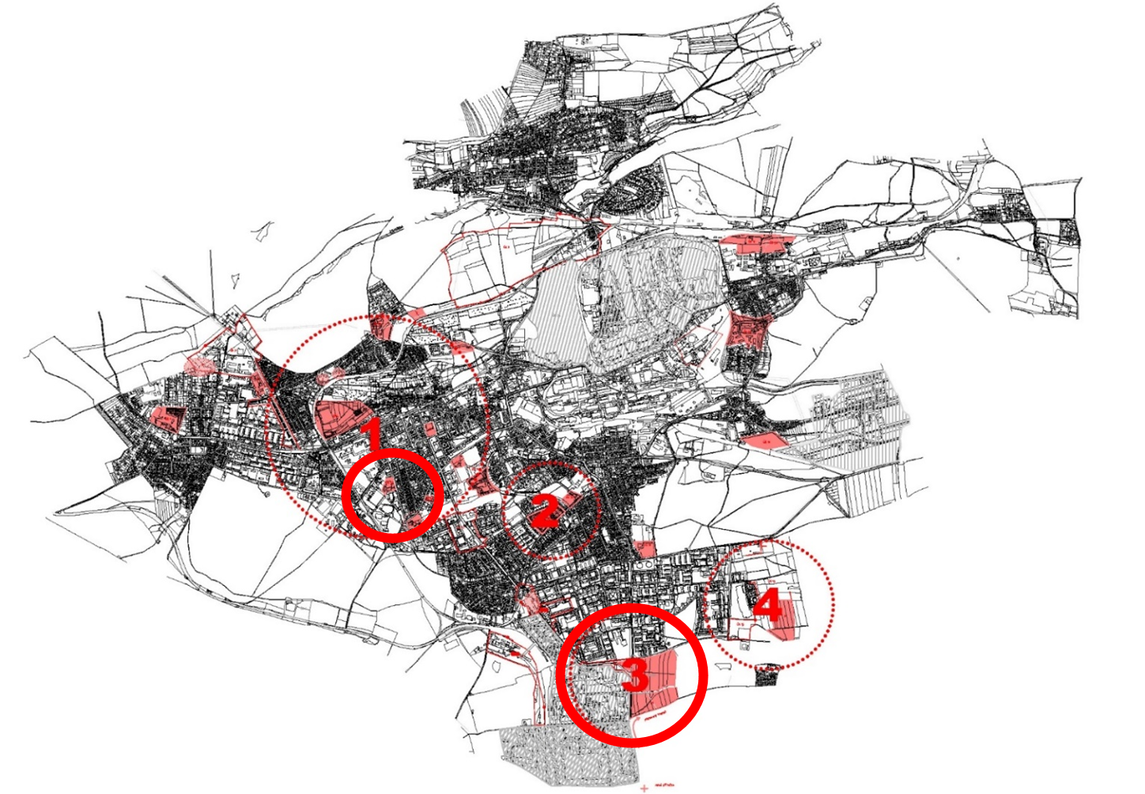
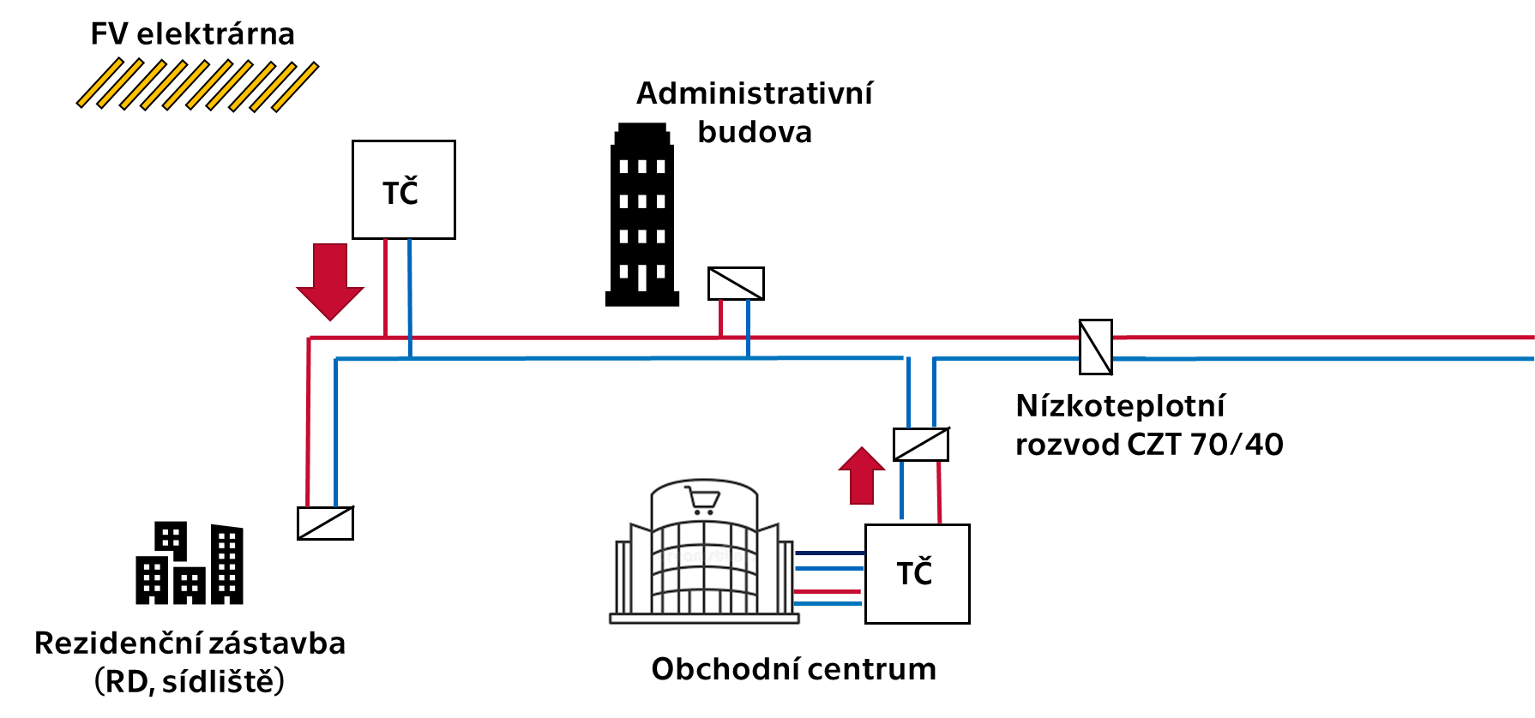
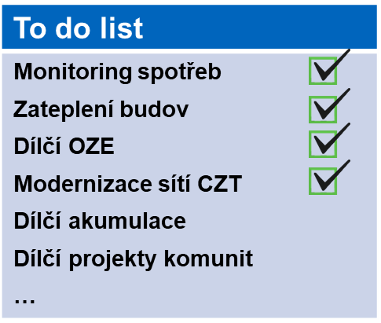
SPARCS KLADNO: EXISTING BUILDINGS
(1) TERRITORY SELECTION
(2) NAMING OPPORTUNITIES
Municipal buildings
BD, SVJ, private individuals
Consumption
Industrial enterprises and services
Production
Heating plant/
power plant
Distribution system operator
(3) FINDING A MODEL OF COOPERATION
(4) PRIORITISATION OF PROJECTS
Source: CTU UCEEB (SPARCS 2020)
Notes:
Other similar to Kněžice, Budišov nad Budišovkou
The micro power plant in Mikolajice heats and supplies electricity to three buildings owned by the municipality - the municipal office, the fire station and the grocery store.
"The project, which includes photovoltaics, battery storage, heat and power distribution throughout all three buildings, works exactly as we de facto dreamed it would. We supply the electricity and we supply the heat to the buildings. In the event of a power outage, we are able to go in what is known as off grid and supply the buildings with electricity for a minimum of 12 hours," says Mikolajice Mayor Martin Krupa.
The total cost of the project, excluding VAT, amounted to CZK 4.4 million. Eighty percent of the costs were covered by the subsidy, the municipality paid CZK 900,000 from its own funds. Mikolajice expects to save CZK 200,000 annually on electricity and the heating engineer's salary, so the costs should be recovered within five years.

Slide 15
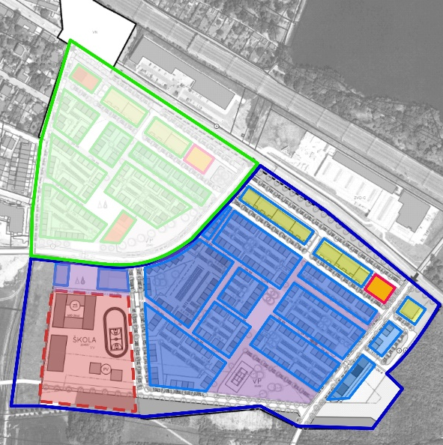
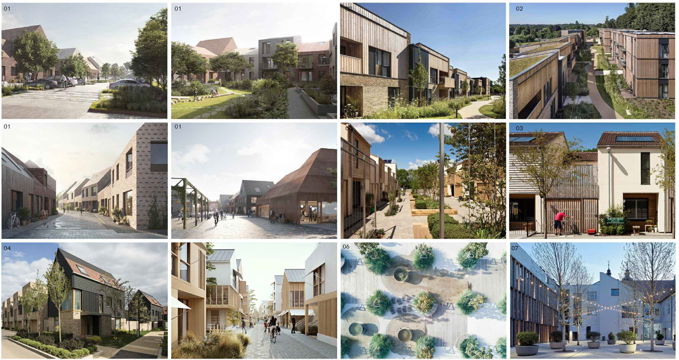
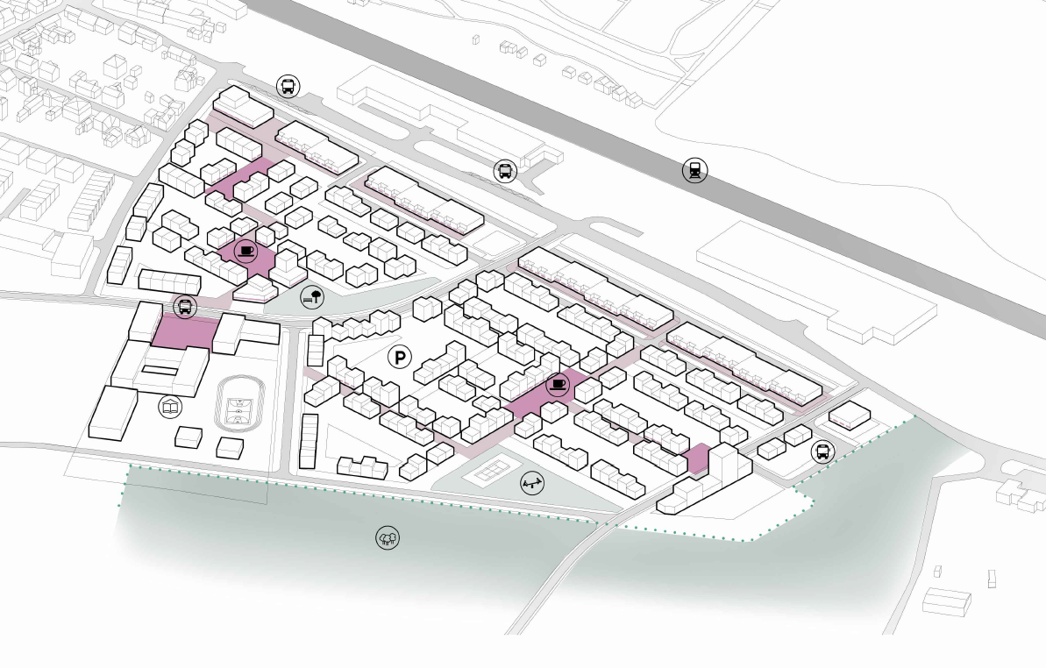

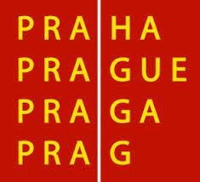

ASCEND: NEW CONSTRUCTION
Accelerate poSitive Clean ENergy Districts
Partners: Operator ICT, Prague Development Company (TBD: Prague Renewable Energy Centre)
Location: Dolní Počernice, Stage II
1600 inhabitants,129 thousand m² , school 12 thousand m²
Local heat supply network, maximization of local production from PV plants, examination of hydrogen economy
Source: the Prague Development Company, Archum

Slide 16

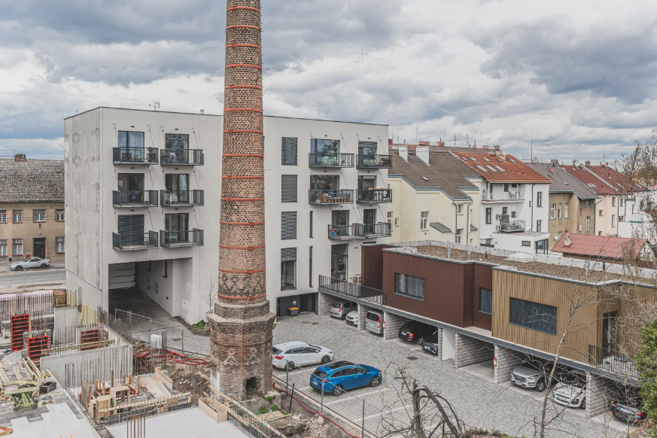
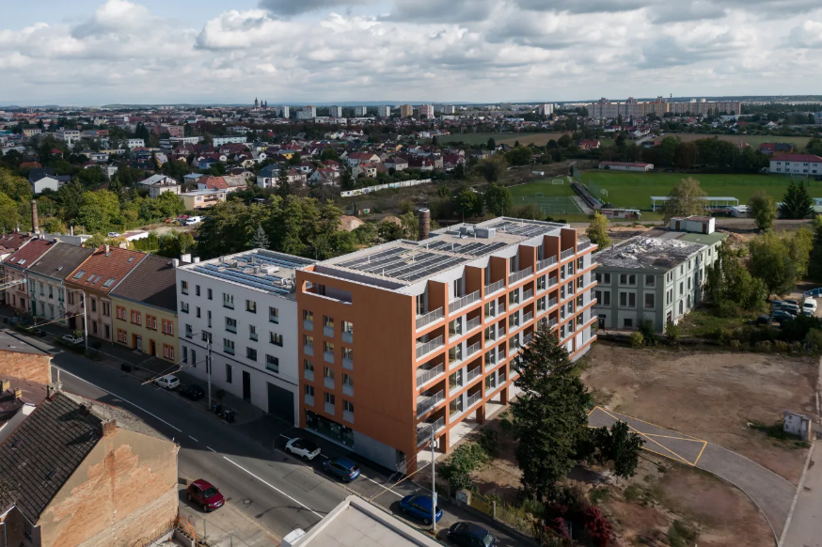


RESILIENT ENERGY COMMUNITY IN PED KUKLENY
RESPED
Source. Author of the energy concept Petr Vogel
Residential buildings, over 400 residential units
Virtual boundaries of a carbon-neutral district, will use wind farms as a source of RES in winter
Avoids the dilemma of excessive imbalance of EE production in summer and winter
By purchasing a flat, the owners of the flats become members of the energy community
The aim of the UCEEB is to verify by simulation whether this model will provide energy resilience

Slide 17

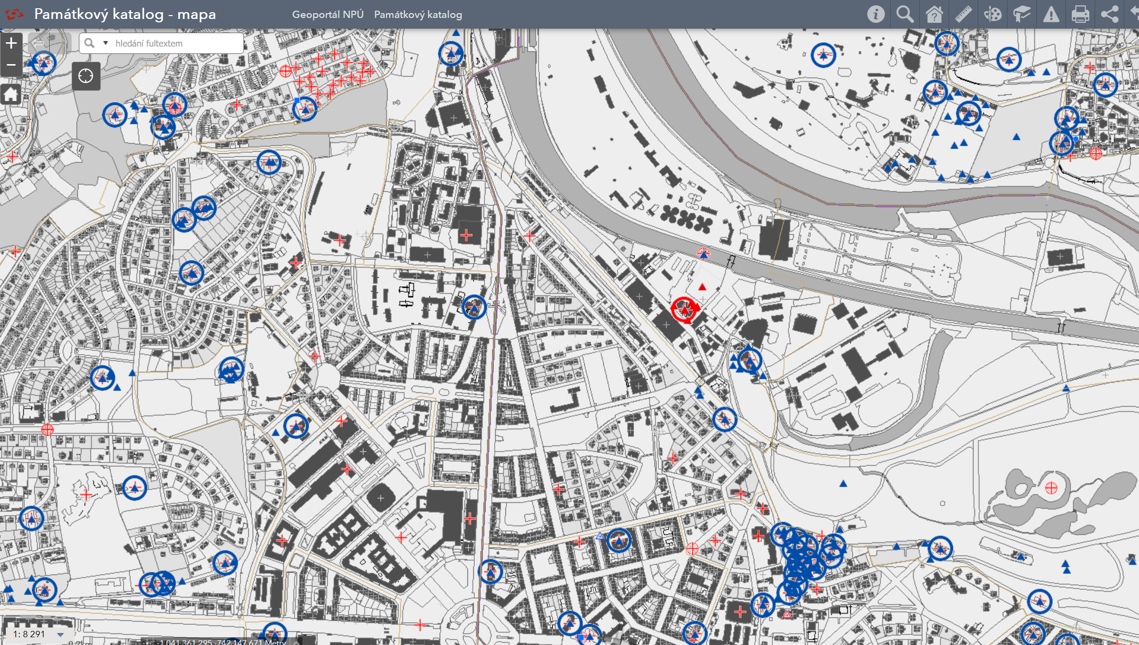
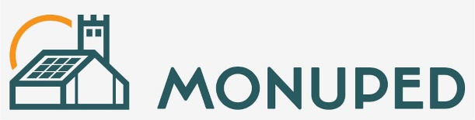
RES SOLUTIONS FOR HISTORIC BUILDINGS
MonuPED - Mainstreaming governance, co-investment and technology solutions for Positive Energy Districts in monument protected areas 2025+

Slide 18
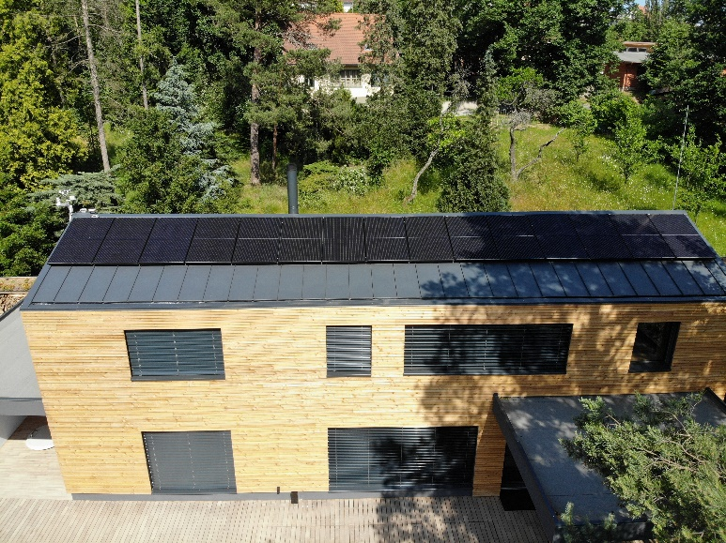
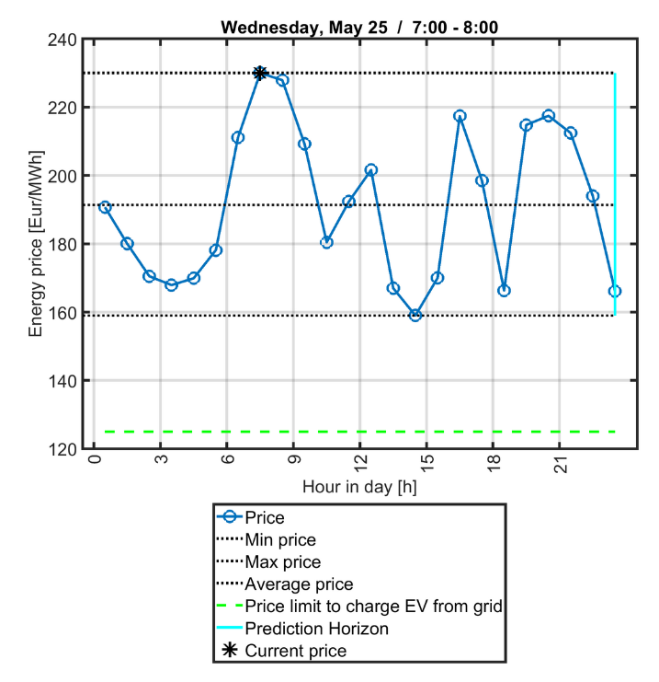
PILOTING ENERGY FLEXIBILITY
ON A FAMILY HOME
Power sources: solar + grid + battery (Enyaq second-life car)
Model-based predictive control (using weather + load forecasting)
Heuristic algorithm for flexible hourly energy trading (buy/sell)
Operation from 2021, energy sales added 2022
Detailed measurements (24 channels), indoor air quality, water consumption, etc.
Local energy forecast model based on sky tracking (www.PVforecast.cz)
NCK CAMEB
Source.

Slide 19
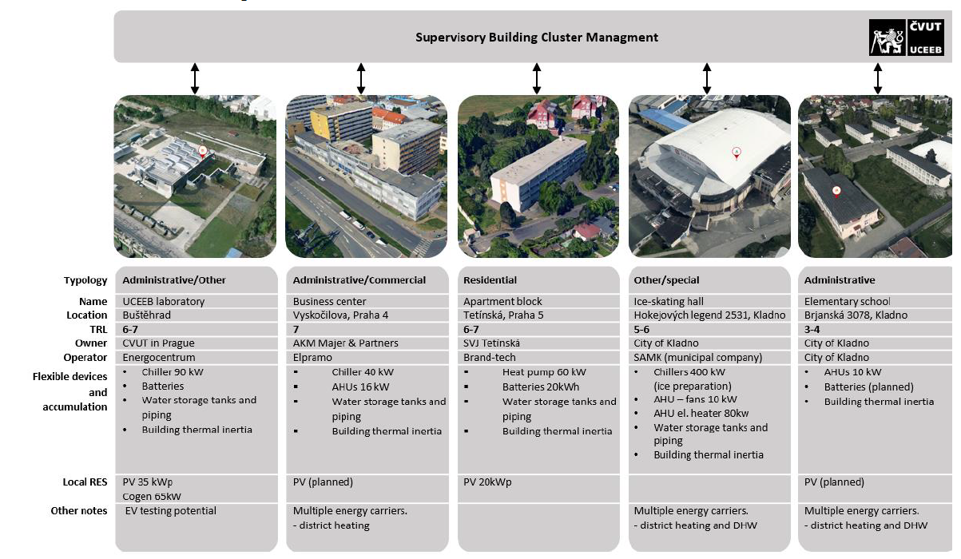
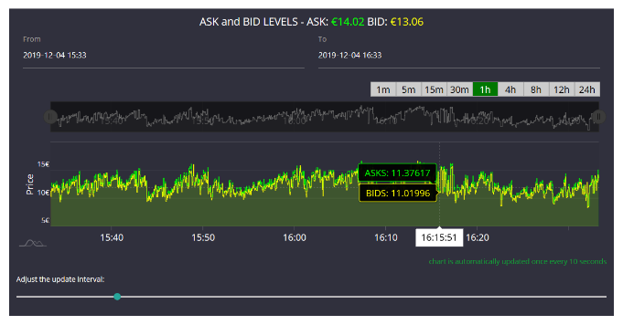

FUTURE? AGGREGATING DEMAND-RESPONSE
Building portfolio management using HVAC and RES energy on-site flexibility (Kladno and Prague, Czech Republic)
A Global as well as Local Flexibility Marketplace to Demonstrate Grid Balancing Mechanisms through Cross-sectoral Interconnected and Integrated Energy Ecosystems enabling Automatic Flexibility Trading (No. 101096399)

Slide 20



Slide 21
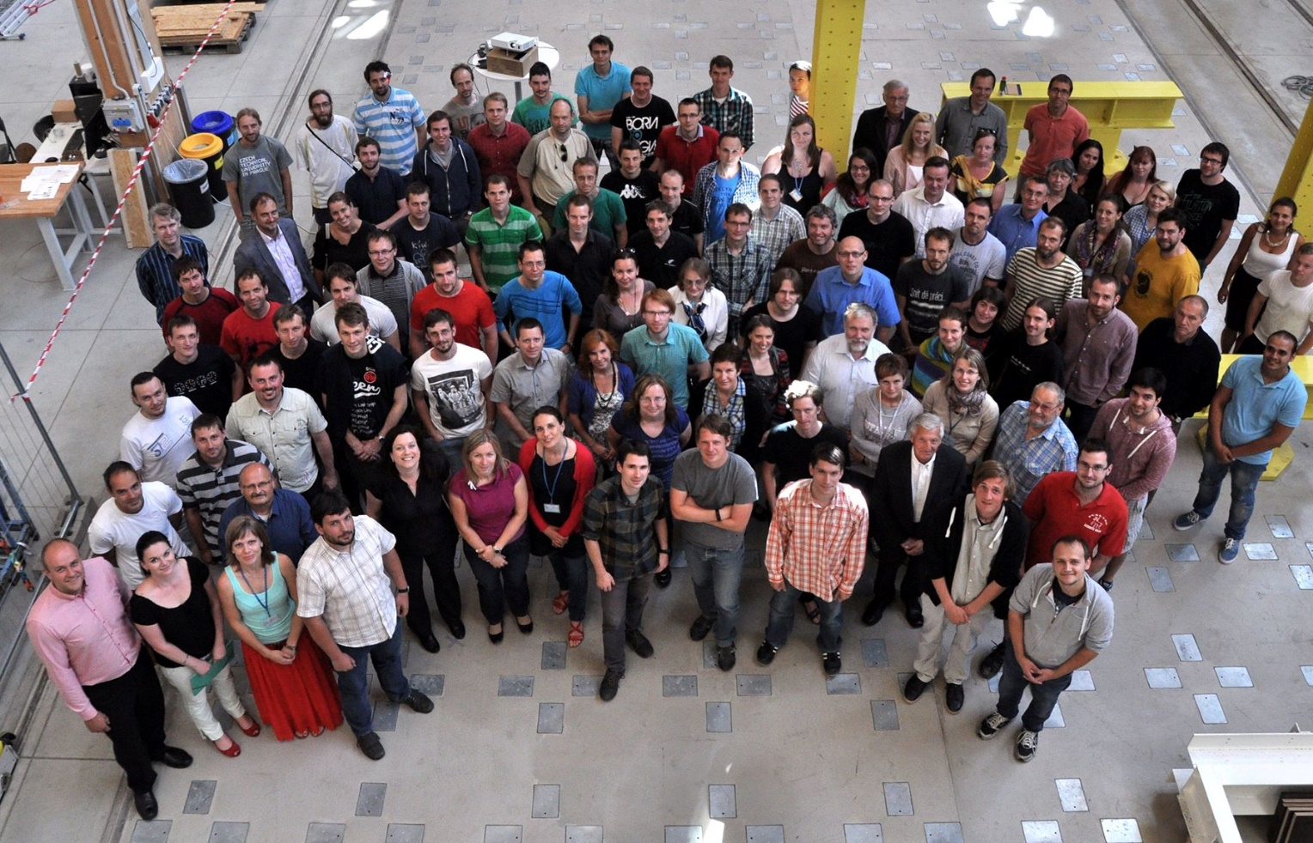
Thank you for your attention michal.kuzmic@cvut.cz

